Slide 1

Computer Architecture and Operating Systems CS 3230: Operating System Section Lecture OS-3 CPU Scheduling
Department of Computer Science and Software Engineering
University of Wisconsin-Platteville

Slide 2
Outlines
CPU Scheduler
CPU Scheduling Criteria
CPU Scheduling Algorithms
Multilevel Queue Scheduling
Traditional UNIX Scheduling

Slide 3
CPU Scheduler
CPU scheduler (short-term scheduler) selects a process from the ready queue and lets it run on the CPU
Known as the dispatcher
Executes most frequently

Slide 4
CPU Scheduler Types
Scheduler type depends on scheduling decisions modes
Two types:
Non-preemptive:
Once a process is in the running state, it will continue until it terminates or blocks itself for I/O
Preemptive
Currently running process may be interrupted and moved to the Ready state by the operating system
Allows for better service since any one process cannot monopolize the processor for very long

Slide 5
CPU Scheduling Criteria
System oriented:
maximize CPU utilization
scheduler needs to keep CPU as busy as possible. Mainly, the CPU should not be idle if there are processes ready to run
maximize throughput
number of processes completed per unit time
ensure fairness of CPU allocation
should avoid starvation – process is never scheduled
minimize overhead – due to context switches or policy computation

Slide 6
CPU Scheduling Criteria
User oriented:
minimize turnaround time
interval from time process becomes ready till the time it is done
minimize waiting time
sum of periods spent waiting in the ready queue
minimize response time
time from process entering the ready queue till it is first scheduled

Slide 7
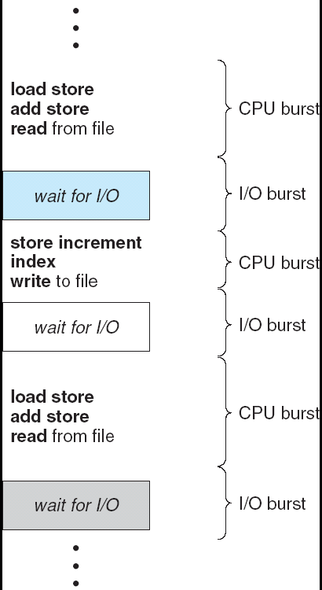
CPU Burst
A process switches between
CPU burst : computing
I/O burst : waiting for I/O
Processes types
CPU-bound — does mostly computation
(long CPU burst), and very little
I/O (short I/O burst)
I/O-bound — does mostly I/O, and
very little computation
(short CPU burst)

Slide 8
CPU Scheduling Algorithms
First Come First Served (FCFS)
Shortest Job First (SJF)
Shortest Remaining Time (SRT)
Priority Scheduling
Round-Robin (RR)

Slide 9
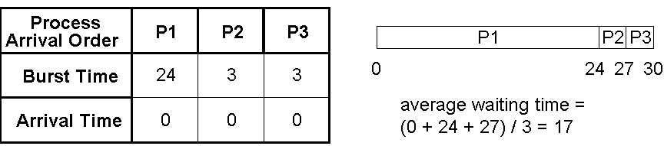
First Come First Served (FCFS)
add to the rear of the ready queue, dispatch from the front
Example 1
Gantt Chart
Example 2
Process
P3
P2
P1
P3
P2
P1
Arrival Order
0
3
6
30
Burst Time
3
3
24
average waiting time =
(0 + 3 + 6) / 3 = 3
Arrival Time
0
0
0
Notes:
Waiting time = time it enters – arrival time

Slide 10
FCFS Evaluation
Non-preemptive
Simple : minimize scheduling overhead
No starvation
convoy effect – one long-burst process is followed by many short-burst processes, short processes have to wait a long time
Unfair : penalizes short-burst processes

Slide 11
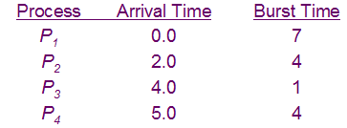

Shortest Job First (SJF)
Select the process that has the smallest CPU burst
Example:
Gantt Chart
Average waiting time
(0+6+3+7)/4 = 4
Notes:
Waiting time = time it enters – arrival time

Slide 12
SJF Evaluation
Non-preemptive
Unfair : penalizes long-burst processes
long processes may have to wait until a large number of short processes finish
Starvation — possible for long processes
High overhead
requires recording and estimating CPU burst times

Slide 13
Shortest Remaining Time (SRT)
Preemptive version of SJF
Scheme:
if a new process arrives with CPU burst length less than remaining time of current executing process, preempt

Slide 14

SRT Example
Example:
Gantt Chart
Average waiting time
(9 + 1 + 0 +2)/4 = 3
Notes:
Waiting time = time it enters last (the process when it completes) – arrival time – burst time used already
Ex. P1 wait time = 11 – 0 – 2 (because P1 was processed from 0 to 2)
P2 wait time = 5 – 2 – 2
P3 wait time = 4 – 4 – 0
P4 wait time = 7 – 5 – 0

Slide 15
SRT Evaluation
Preemptive
Optimal waiting and response times
High throughput
Unfair : penalizes long-burst processes
long processes may have to wait until a large number of short processes finish
note that long processes may eventually become short processes
Starvation — possible for long processes
High overhead
requires recording and estimating CPU burst times

Slide 16
Priority Scheduling
A priority number (integer) is associated with each process
The CPU is allocated to the process with the highest priority (smallest integer ≡ highest priority)
Preemptive
nonpreemptive
SJF is a priority scheduling where priority is the predicted next CPU burst time
Problem ≡ Starvation – low priority processes may never execute
Solution ≡ Aging – as time progresses increase the priority of the process

Slide 17
Round Robin (RR)
Preemptive version of FCFS
Scheme:
define a fixed time slice (also called a time quantum) – typically 10-100ms
choose process from head of ready queue
run that process for at most one time slice, and if it hasn’t completed or blocked, add it to the tail of the ready queue
choose another process from the head of the ready queue, and run that process for at most one time slice
Implement using hardware timer that interrupts at periodic intervals
Performance:
q large ⇒ FIFO
q small ⇒ q must be large with respect to context switch, otherwise overhead is too high

Slide 18
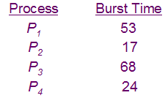

RR Example
Example with q=20:
Gantt Chart
Average waiting time
(81 + 20 + 94 +97)/4 = 73
Notes:
Waiting time = time it enters last (the process when it completes) – arrival time – burst time used already
P1 wait time = 121 – 0 – 40 = 81
P2 wait time = 20 – 0 – 0 = 20
P3 wait time = 134 – 0 – 40 = 94
P4 wait time = 117 – 0 – 20 = 97

Slide 19
RR Evaluation
Preemptive
Low overhead
No Starvation
penalizes I/O bound processes
may not use full time slice
Throughput — depends on time quantum
Long processes may have to wait n *q time units for another time slice
n = number of other processes

Slide 20
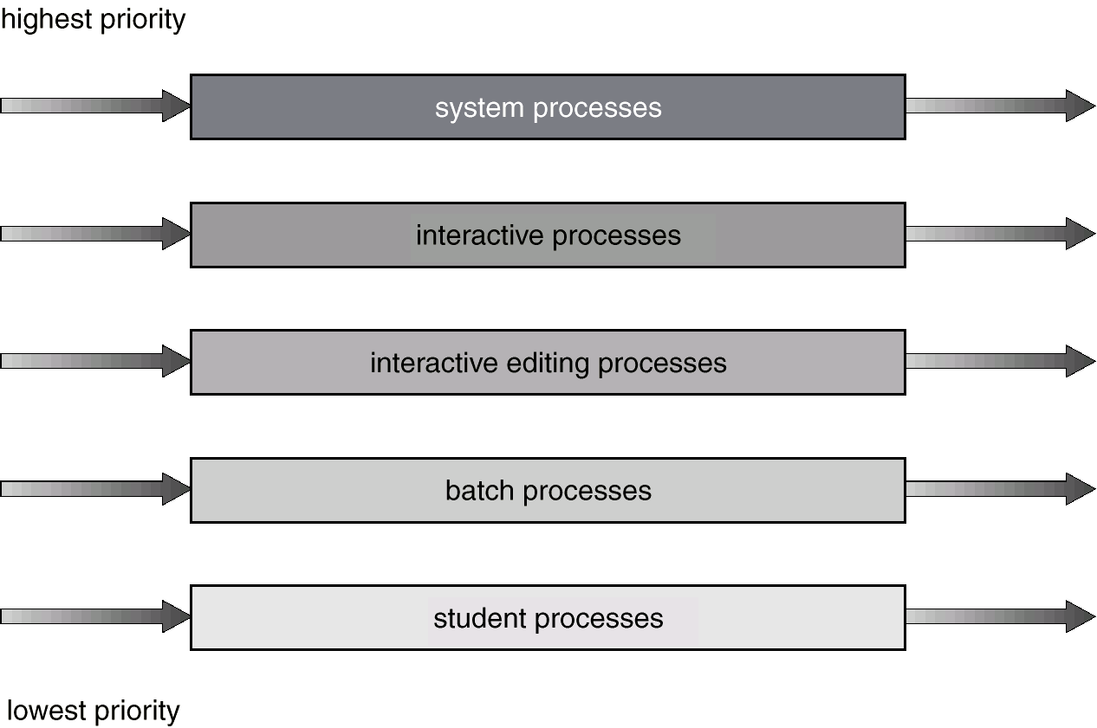
Multilevel Queue Scheduling

Slide 21
Multilevel Feedback Queue
A process can move between the various queues; aging can be implemented this way.
Multilevel-feedback-queue scheduler defined by the following parameters:
number of queues
scheduling algorithms for each queue
method used to determine when to upgrade a process
method used to determine when to demote a process
method used to determine which queue a process will enter when that process needs service

Slide 22
Multilevel Queue
Ready queue is partitioned into separate queues:
foreground (interactive)
background (batch)
Each queue has its own scheduling algorithm,
Example:
foreground – RR
background – FCFS
Scheduling must be done between the queues.
Fixed priority scheduling; (i.e., serve all from foreground then from background). Possibility of starvation.
Time slice – each queue gets a certain amount of CPU time which it can schedule amongst its processes;
Example :
80% to foreground in RR
20% to background in FCFS

Slide 23
Multilevel Feedback Queue Example
Three queues:
Q₀ – time quantum 8 milliseconds
Q₁ – time quantum 16 milliseconds
Q₂ – FCFS
Scheduling
A new job enters queue Q₀ which is served FCFS. When it gains CPU, job receives 8 milliseconds. If it does not finish in 8 milliseconds, job is moved to queue Q₁.
At Q₁ job is again served FCFS and receives 16 additional milliseconds. If it still does not complete, it is preempted and moved to queue Q₂.
Notes:
Note: Q2 is using round robin, but the quantum is very large, so it becomes FCFS

Slide 24
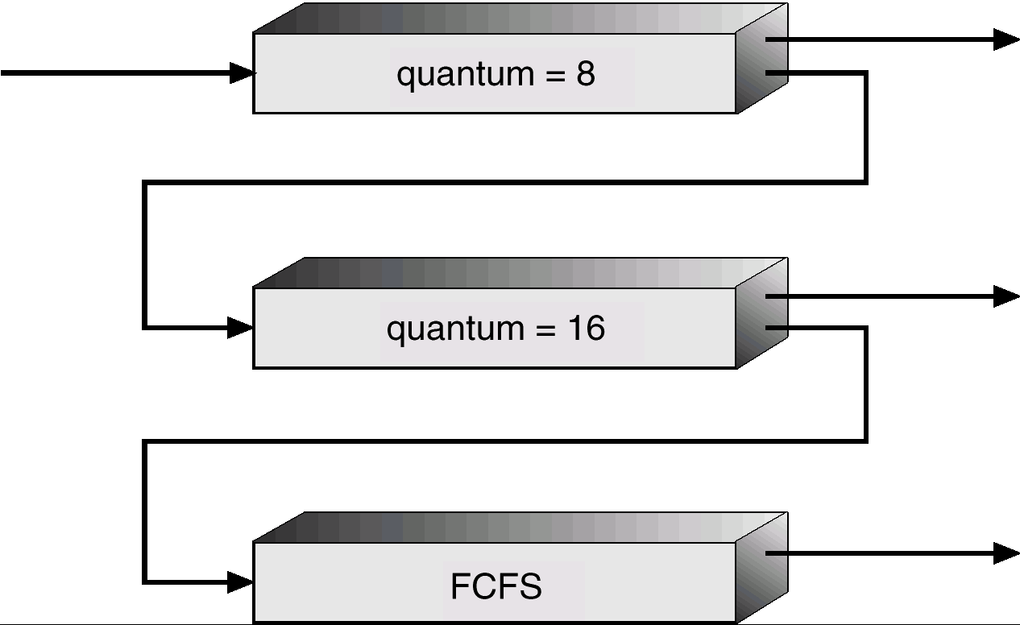
Multilevel Feedback Queue Example
Notes:
Note: Q2 is using round robin, but the quantum is very large, so it becomes FCFS
Priority is for Q0
- if Q0 is empty: Q1
- if Q0 and Q1 empty: Q2

Slide 25
Traditional UNIX Scheduling
Multilevel feedback using round robin within each of the priority queues
Priorities are recomputed once per second
Base priority divides all processes into fixed bands of priority levels
Adjustment factor used to keep process in its assigned band

